Slide 1
Introduction to Deep Learning
Why it Matters in Modern AI & Data Science

Slide 2
Contents
01
02
What is Deep Learning?
Evolution of AI ,ML and DL
03
04
Machine Learning vs. Deep Learning
Applications of Deep Learning
05
06
Deep Learning Model Architectures
When is Traditional ML Preferred

Slide 3



Deep Learning in Your Daily Life
Netflix / YouTube
ChatGPT
Personalized recommendations
Answers your questions
📱 Face Unlock
🩺 Medical Imaging
Recognizes your face
Detects diseases
All of this is powered by Deep Learning

Slide 4
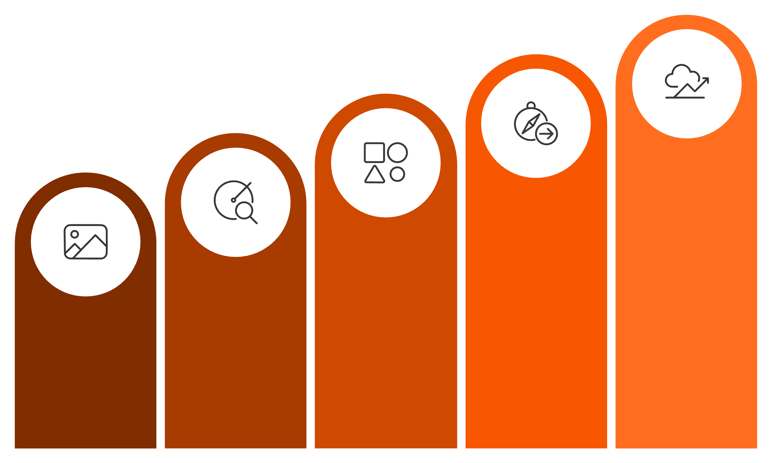

What is Deep Learning?
Deep learning is a subset of machine learning that uses multi-layer neural networks to automatically learn
hierarchical representations directly from raw data — no manual feature engineering required.
Prediction
Objects
Shapes
Edges
Pixels
Each layer extracts increasingly abstract features, enabling powerful pattern recognition in unstructured data such
as images, speech, and text.

Slide 5



Evolution: AI → ML → Deep Learning
Artificial Intelligence
Machine Learning
Deep Learning
Broad goal: machines capable of intelligent behavior
Systems learn patterns from data without explicit programming
Specialized ML using deep neural networks with multiple hidden layers

Slide 6
Why Deep Learning Became Practical
1
2
3
Large Data Availability
Computing Power
Algorithmic Improvements
Datasets like ImageNet provide millions of labeled examples for training.
GPUs enable efficient parallel computation at scale.
Key advances: ReLU activation, Adam optimizer, and dropout regularization.

Slide 7
Machine Learning vs. Deep Learning
Deep learning is theoretically a subset of ML, but practically treated as a separate paradigm.
Machine Learning Pipeline
Deep Learning Pipeline
Data → Feature Engineering → Model → Prediction
Raw Data → Deep Neural Network → Prediction
Features are manually designed by domain experts.
The network automatically learns relevant features from data.

Slide 8
ML vs. Deep Learning
Comparison of key aspects across both paradigms
Aspect
Machine Learning
Deep Learning
Feature Engineering
Manual
Automatic
Data Size
Small–Medium
Large
Training Time
Faster
Slower
Hardware
CPU often enough
GPU often required
Interpretability
Higher
Lower

Slide 9
Applications of Deep Learning
Computer Vision
Natural Language Processing
Image classification, face recognition, medical imaging
Machine translation, chatbots, text summarization
Speech Recognition
Autonomous Systems
Voice assistants, dictation systems
Self-driving vehicles, robotics

Slide 10
Deep Learning in Computer Vision
Computer vision enables machines to interpret visual data.
Convolutional Neural Networks (CNNs) are the dominant architecture.
Image Classification
Object Detection
Assign a label to an entire image
Locate and identify multiple objects in a scene
Face Recognition
Medical Imaging
Identify individuals from facial features
Diagnose conditions from X-rays, MRIs, and scans
CNNs learn hierarchical visual patterns — from edges → shapes → objects — through successive convolutional layers.

Slide 11
Deep Learning in Natural Language Processing
NLP focuses on enabling machines to understand and generate human language. Deep learning models learn semantic representations directly from text.
Sentiment Analysis
Machine Translation
Question Answering
Classify the emotional tone of text
Translate text across languages automatically
Retrieve precise answers from large text corpora
Modern NLP systems predominantly use Transformer architectures (e.g., BERT, GPT).

Slide 12




Deep Learning Architecture Types
Feedforward Networks
Convolutional Neural Networks
Information flows in one direction from input to output through fully connected layers. Best for structured data and basic classification tasks.
Specialized for processing grid-like data such as images, using convolutional layers to detect local patterns and spatial relationships.
Recurrent Neural Networks
Transformers
Designed for sequential data with memory capabilities, allowing information to persist across time steps for temporal pattern recognition.
Attention-based architectures that can process sequences in parallel, revolutionizing natural language processing and computer vision tasks.

Slide 13
Deep Learning Models-Architectures
Key deep learning architectures and their primary application domains
Architecture
Used For
Example
CNN
Images / Vision
Pneumonia detection
RNN / LSTM
Sequential data
Speech recognition
Transformer
Language / Modern AI
ChatGPT

Slide 14
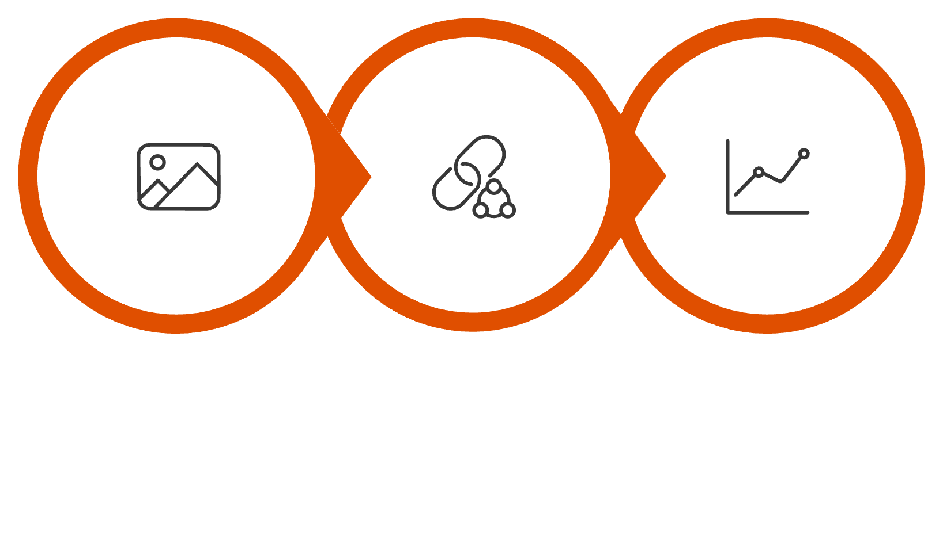
Case Study 1: Pneumonia Detection from Chest X-rays
Problem
Detect pneumonia from chest X-ray images automatically.
Approach
CNNs trained on large labeled X-ray datasets to identify abnormal lung patterns.
Impact
X‑ray Input
CNN Features
Classification
Faster hospital screening
Early detection of lung infections
Decision support for radiologists

Slide 15
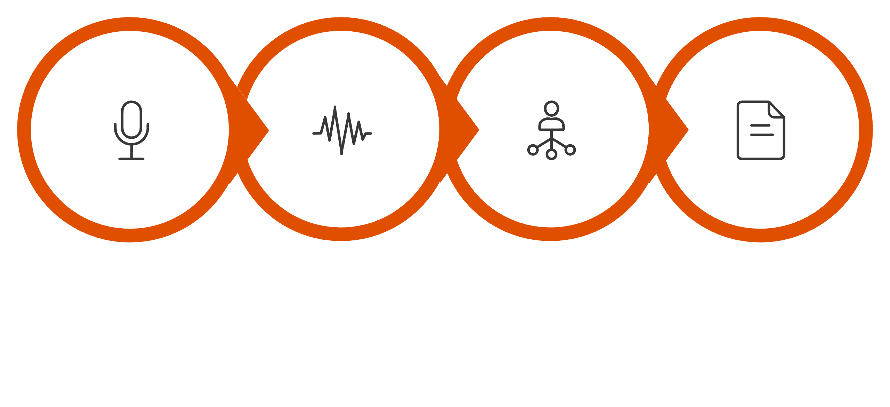
Case Study 2: Speech Recognition
Speech recognition converts spoken language into written text — e.g., "Schedule a meeting tomorrow at 10 AM."
Deep Network
Language Model
Capture
Spectrogram
RNN
LSTM
Transformer
Recurrent Neural Networks for sequential data
Long Short-Term Memory for long-range dependencies
Attention-based models for state-of-the-art speech

Slide 16
When Traditional Machine Learning is Preferable
Deep learning is not always the right tool. Traditional ML is preferable when:
1
2
Small or Moderate Dataset
Structured Data
Deep learning requires large data to generalize well
Tabular data suits classical algorithms better
3
4
Feature Control Required
Interpretability Matters
Domain expertise can be directly encoded
Logistic regression, decision trees, and random forests are explainable

Slide 17
Example: Credit Risk Prediction
Input Features
Models Used
Income
Credit score
Loan amount
Employment history
These models deliver strong predictive performance with interpretability — critical in regulated banking environments.
Logistic Regression
Random Forest
Gradient Boosting

Slide 18
Mathematical Foundations of Deep Learning
Linear Algebra
Probability & Statistics
Matrix and tensor operations underpin all neural network computations
Loss functions and uncertainty quantification
Optimization
Calculus
Gradient descent and stochastic gradient descent (SGD)
Backpropagation uses derivatives to update network weights

Slide 19
Python Ecosystem for Deep Learning
Core Frameworks
Supporting Libraries
TensorFlow
NumPy
Pandas
Google — large-scale ML systems
Numerical computation
Data manipulation
PyTorch
Matplotlib
Scikit-learn
Widely used in academic research
Visualization
Classical ML utilities
Keras
High-level API for rapid prototyping

Slide 20
Key Takeaways
1
Deep Learning automates feature learning
Multi-layer networks extract hierarchical representations from raw data
2
Three enablers: Data, GPUs, Algorithms
Large datasets, parallel computing, and improved optimizers made DL practical
3
Dominant in vision, language, and speech
CNNs and Transformers power state-of-the-art applications
4
Traditional ML still has its place
Structured data, small datasets, and interpretability favor classical methods
5
Python is the standard ecosystem
TensorFlow, PyTorch, and Keras are the primary tools for practitioners

